Slide 1




DIGITAL LITERACY
SKILLS
BASIC USERS

Slide 2
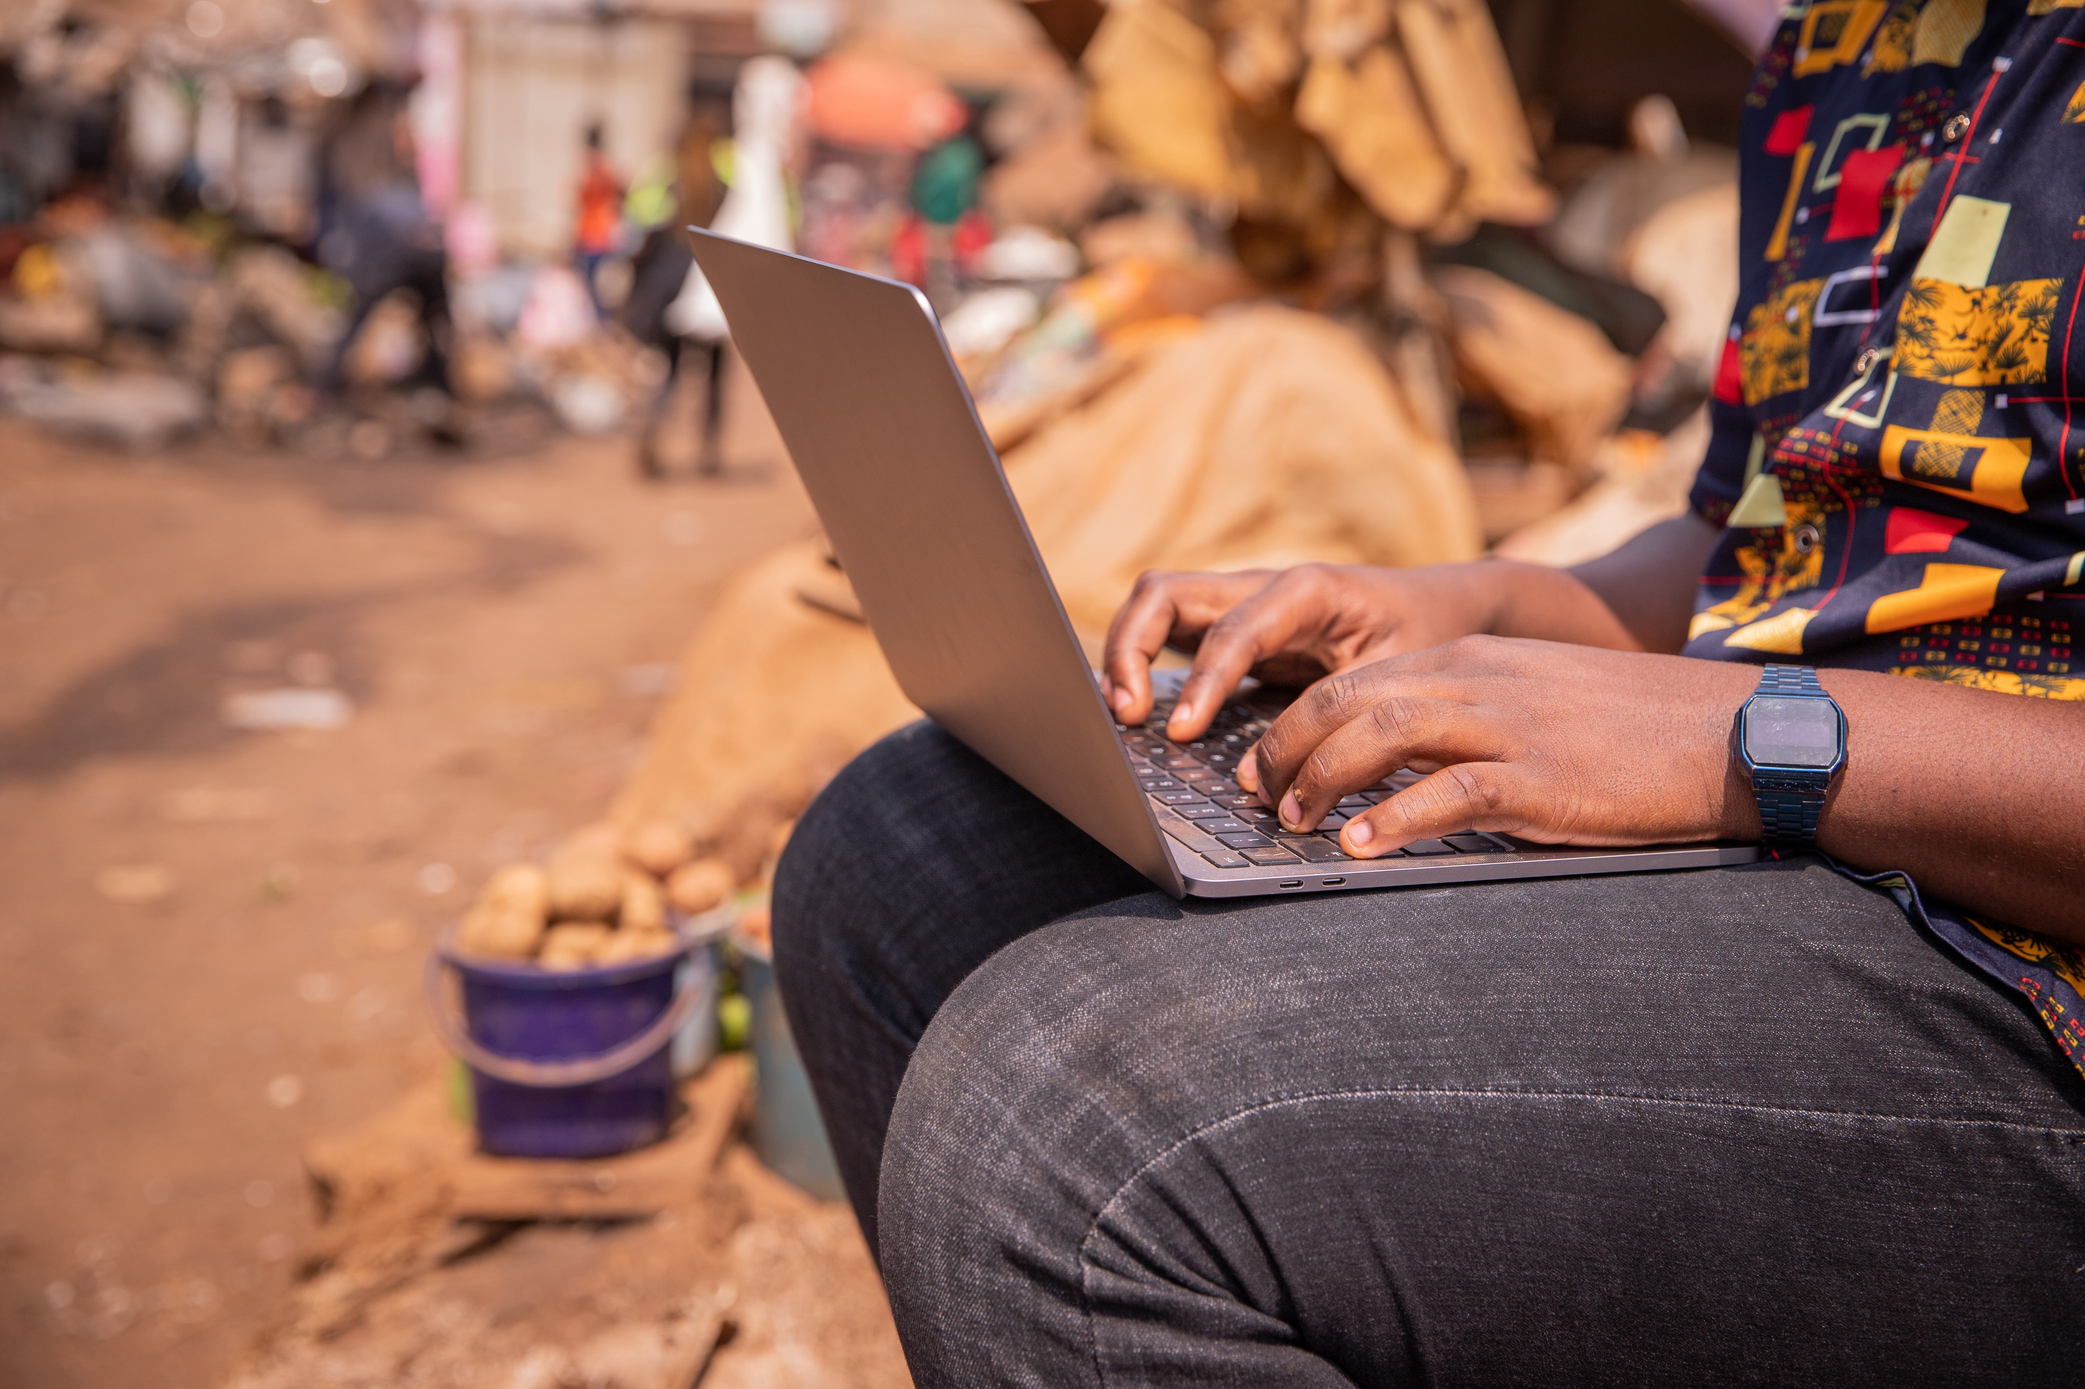
Module 3
Communication
and collaboration

Slide 3

7
Unit 7: Managing digital identity

Slide 4
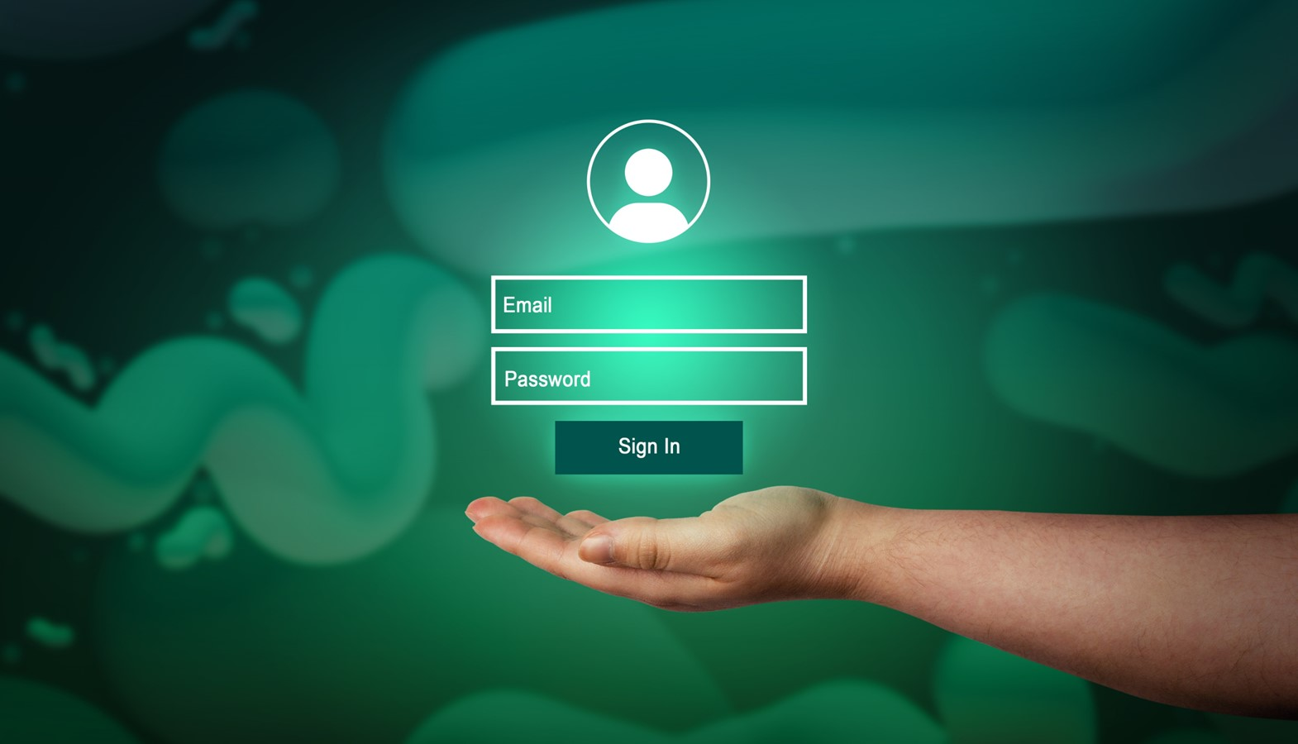
Definitions and protecting identity
The information we leave online about ourselves represents our digital identity. For example, when we use a username and password to authenticate ourselves on a website, we are using our digital identity.
Many services require us to log in from devices. E-commerce, banking, health services, tax services are just a few examples.
Our private data are taken and recorded, often without you even realising it. Therefore, you need to be aware and learn how to best manage your digital identity.

Slide 5

Definition of managing digital identity
Managing digital identity means:
“To create and manage one or multiple digital identities, to be able to protect one's own reputation, to deal with the data that one produces through different digital tools, environments and services”.

Slide 6

Identity theft
Cybercriminals hack and steal our personal or financial data.

Slide 7

How to defend ourselves against cybercriminals
Be very careful when using the internet. Never open suspicious emails or messages. You need to be able to recognize whether the information you receive is true or not.
Ask:
Is it written correctly in your language?
Are there any strange signs?
Does it talk about operations of which you are not aware?

Slide 8

Ways to protect our digital identity
Use two-factor authentication
Change and diversify passwords
Avoid sharing sensitive information

Slide 9
Skills to practise
My digital identity.
Write a short paragraph that shows that you understand your digital identity.
My digital reputation.
Write a short paragraph that shows that you understand how you can protect your digital reputation.
Digital data.
Write a list of the type of data that you produce during one week of online activity.

Slide 10
All back covers should include
contact information of the section
producing the work.
© United Nations Children’s Fund (UNICEF) [month and year of publication]

